Slide 1
CENTRAL GRIEVANCE AND MONITORING SYSTEM(CGMS)
Dynamic Coders

Slide 2

LOGIN PAGE
A/c Number :
Enter your a/c number
Password:
Enter your password
Submit

Slide 3
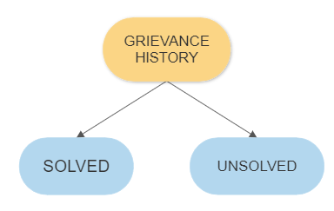
User’s Interface

Slide 4
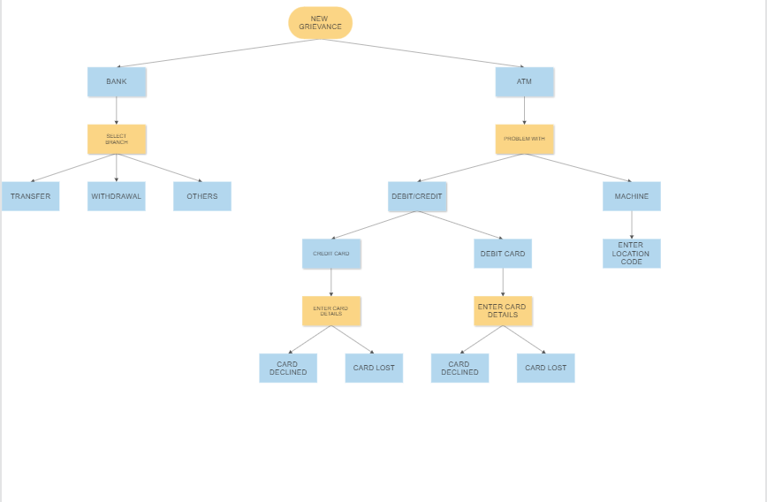
User Interface Contd…

Slide 5
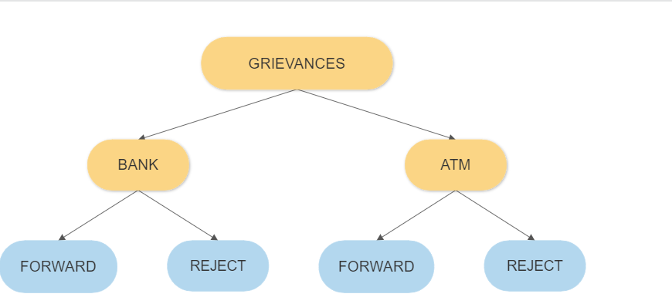
ADMIN INTERFACE

